Slide 1

Thesis Defense
Northeastern University
Software Engineering(International (English))
Respondent
Supervisor
Li Yuanshi
Zhang Mingwei
Class
Student ID
1702
20172259
Notes:
Self introduction 15~20s

Slide 2
Design and Implementation of Educational Administration System in Elementary and Secondary Schools Based on J2EE
Notes:
Introduction of title of the thesis 10s

Slide 3
Contents
I. Abstract
II. Introduction & Related work
III. Requirement analysis
IV. System design
V. System Implementation
VI. System Test
VII. Summary and Prospect
Notes:
Introduction of contents 15~20s

Slide 4

I. Abstract
Notes:
Transition 5s

Slide 5
Chapter One Abstract
1
Development purpose: to deal with the daily educational information management business in primary and secondary schools.
2
Work done: Requirement analysis, System Design, System Implementation and System Design
Significance: The establishment of a unified and standardized educational administration information management platform for local primary and secondary schools can help to improve the level of educational administration affairs, and then improve the quality and level of related education and teaching.
3
Notes:
Introduction to abstract 45~50s

Slide 6
II. Introduction &
Related work
Notes:
Transition 5s

Slide 7
Chapter Two Introduction & Related work
Research Background
According to this table, in the six years of compulsory education, the number of students in school increased by about 20% from 130 million in 2015 to 156 million in 2020. With the growth of the number of students year by year, the teaching staff is also growing, and the task of each teacher and school staff is getting bigger and bigger. With the existing teachers and educational resources, it is a challenge for compulsory education to ensure the orderly teaching work.
The number of primary and secondary school students in 2015-2020
Year | Pupils | Junior students | Total
2015 | 86,930,000 | 43,120,000 | 130,050,000
2016 | 99,130,000 | 43,290,000 | 142,420,000
2017 | 100,940,000 | 44,420,000 | 145,360,000
2018 | 103,390,000 | 46,530,000 | 149,920,000
2019 | 105,610,000 | 48,270,000 | 153,880,000
2020 | 107,250,000 | 49,140,000 | 156,390,000
Notes:
Research background 20s

Slide 8
Chapter Two Introduction
Research Values
Reduce the workload of teachers and educational staff
Speed up the process of informatization
01
Ensure the teaching work in order
Meet the needs of work and help other work in order
03
08
02
Research Status
High degree of automation and informatization
05
04
High degree of fit of new technology
Combined with the existing good school network foundation, realize the specific function for each student in different situations.
07
With the rapid development of machine learning, artificial intelligence, neural network and other fields, this kind of algorithm can be used to optimize educational administration, teaching information arrangement, student performance analysis and other aspects.
06
Notes:
Values and Status 30s

Slide 9
Chapter Two Introduction
Research Contents
(1) Requirement analysis
(2) Database design and implementation
(3) System design
(4) System functional implementation
(5) System test
Notes:
Contents 15~20s

Slide 10
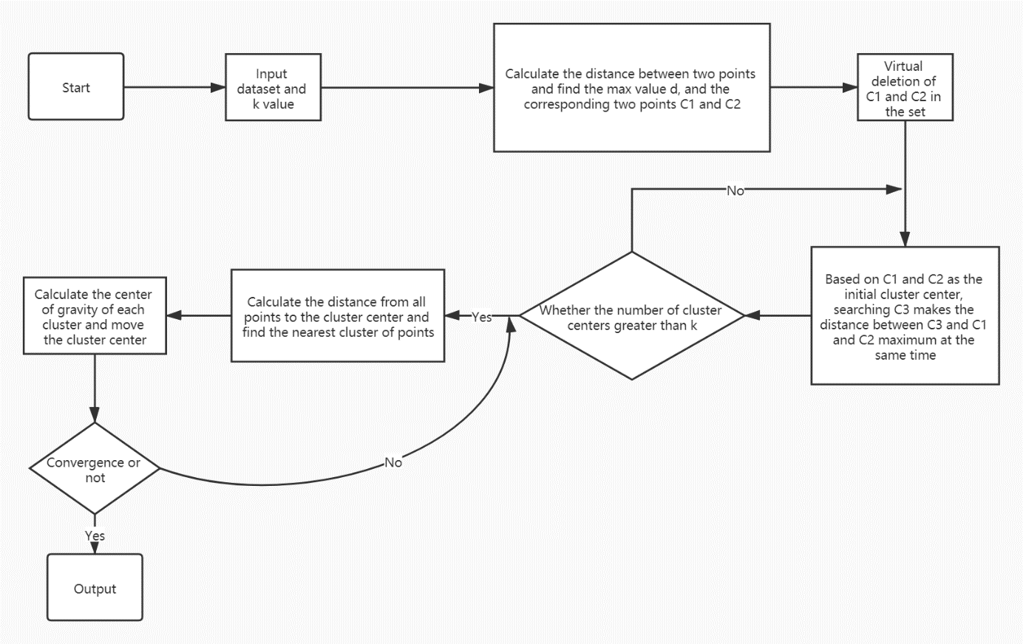
Chapter Two Introduction
Related work
Development mode
Optimized k-Means
Object-oriented development pattern
Separation of frontend and backend
Tools and environments
Navicat, MyBatis, Spring, Vue, Apache Tomcat server
JDK 8, MySQL Ver 8.0.20, Node.js V14.3.0, Spring Boot 2.4.5, Spring cloud 2020.0.2, Vue CLI 4.4.1, Apache Tomcat 9.0.36
Notes:
Related work 40~45s

Slide 11
III. Requirement analysis
Notes:
Transition 5s

Slide 12
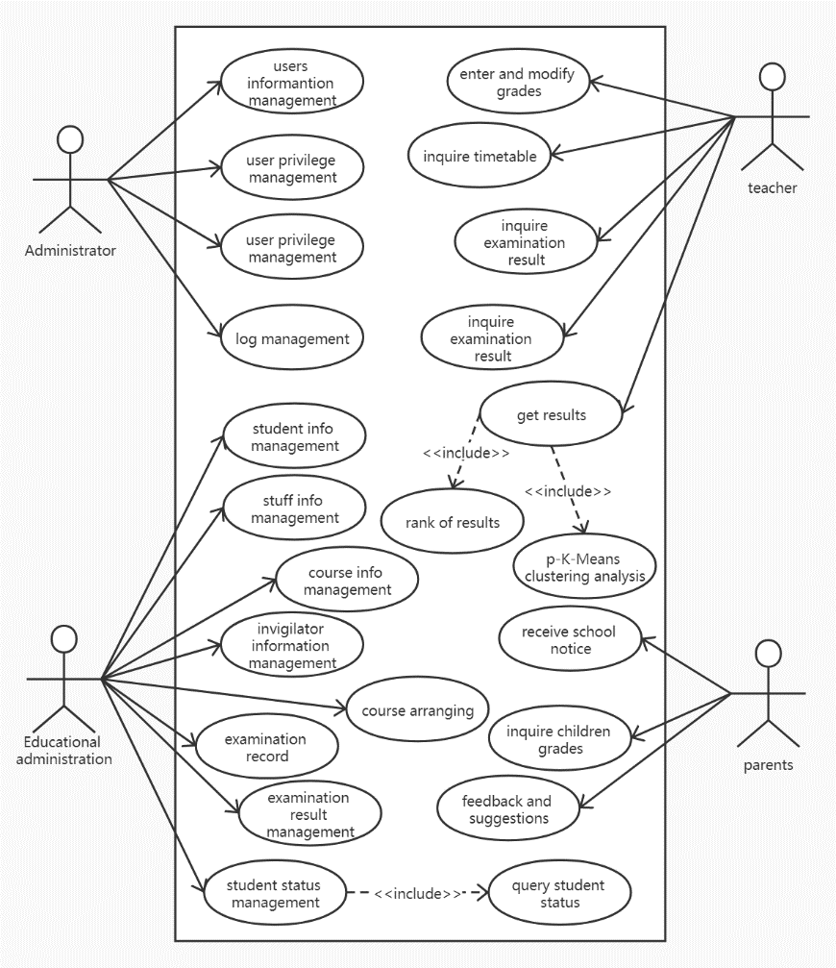
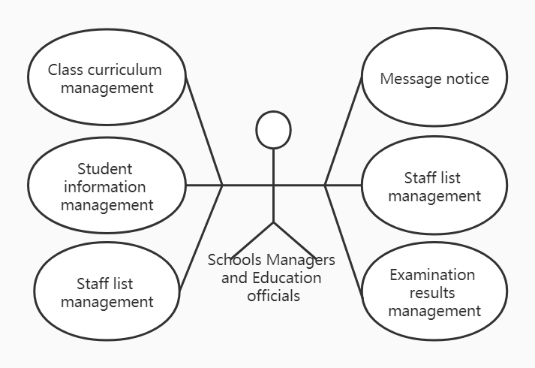
Chapter Three Requirement analysis
Business requirement analysis
User requirement analysis
Notes:
20s

Slide 13
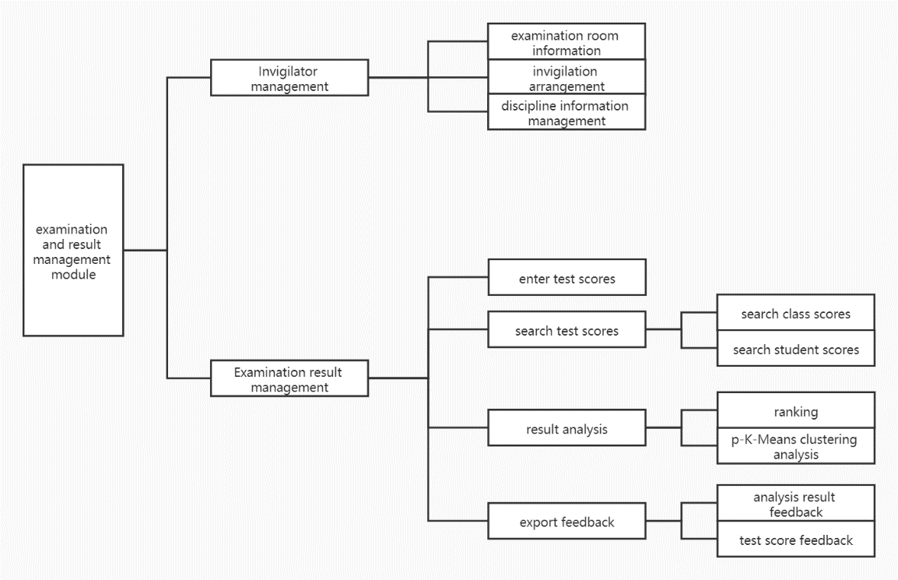
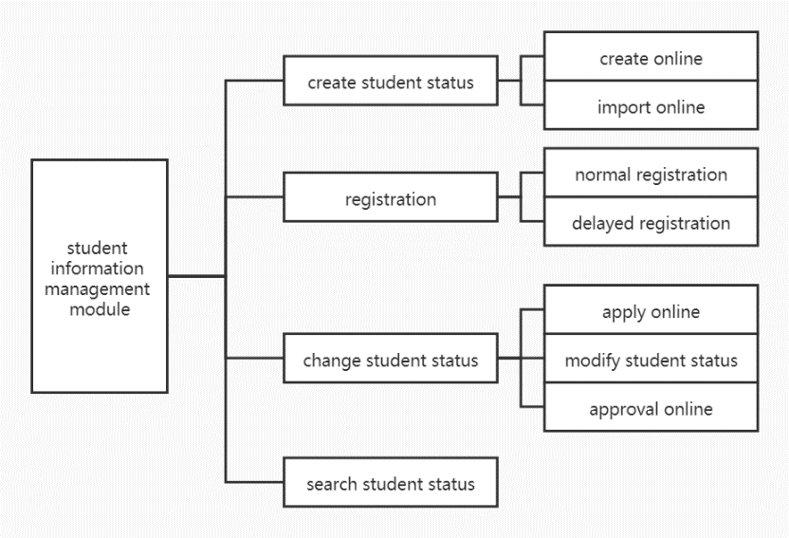
Chapter Three Requirement analysis
Functional requirement analysis
………………………………………………………………………………………
Exam management module
Student information management
Notes:
Functional requirement analysis 30~40s

Slide 14
Chapter Three Requirement analysis
Non-Functional requirement analysis
Education departments and schools first proposed that the system should have good security and be able to keep all kinds of data for a long time. And the system can have good applicability, for all primary and secondary schools can meet the needs of their daily educational work. The education department hopes to develop the information-based educational administration management system with quality and quantity guaranteed, and at the same time to reduce various costs as much as possible. Finally, the school hopes that the new system is easy to operate, and can let the teaching staff know and master the basic business operation process as soon as possible.
For system administrators, the system needs to be safe, reliable and have good performance (reflected in throughput and response time).
For educational administrators, the non-functional requirement of the system is to have strong fault tolerance and ease of use (easy to learn and operate).
For teachers and parents, the system needs to be easy to operate and the best beautiful interface, message reception should be timely, and the system should be real-time.
Notes:
Non-Functional analysis 20~25s

Slide 15
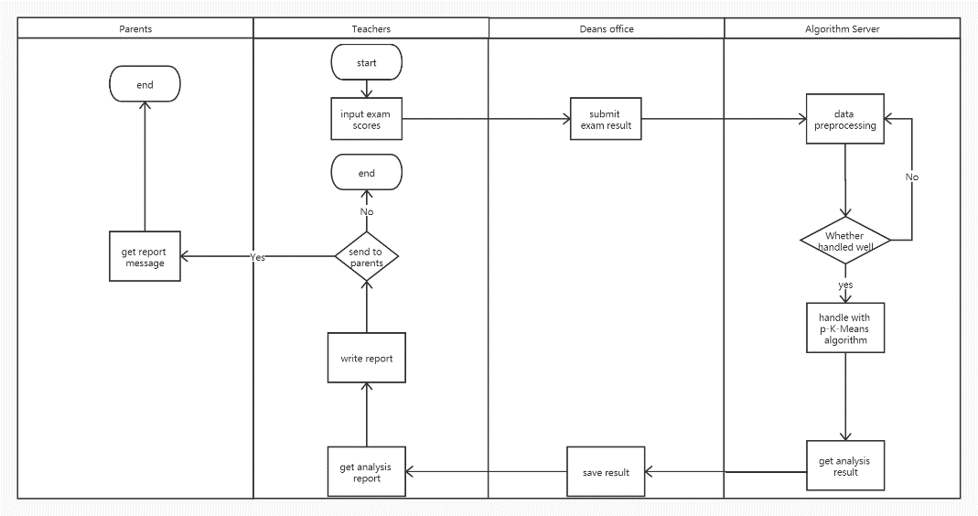
Chapter Three Requirement analysis
Business process analysis
Notes:
15s

Slide 16
IV. System Design
Notes:
Transition 5s

Slide 17
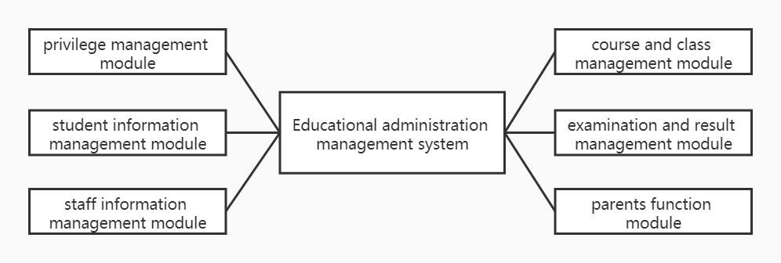
Chapter Four System Design
System Design
Design of overall function module of the system
Notes:
15s

Slide 18
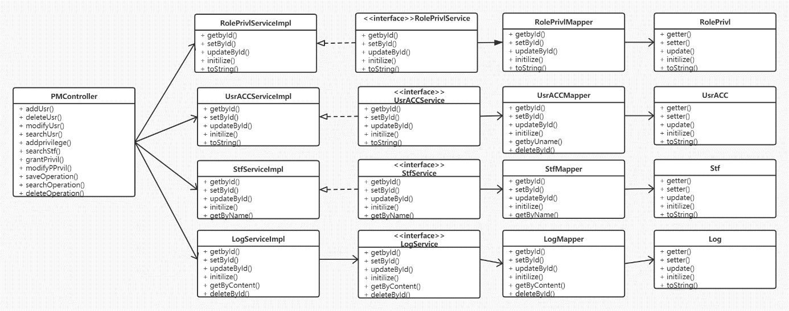
Chapter Four System Design
Privilege management module
Class diagram
Notes:
15s

Slide 19
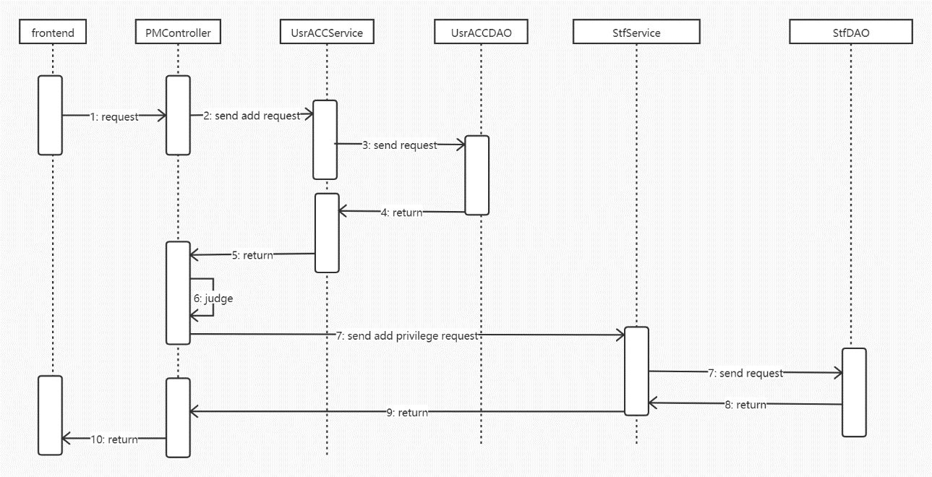
Chapter Four System Design
Privilege management module
Flow chart of adding a new user and grant privilege
Notes:
35~40s

Slide 20
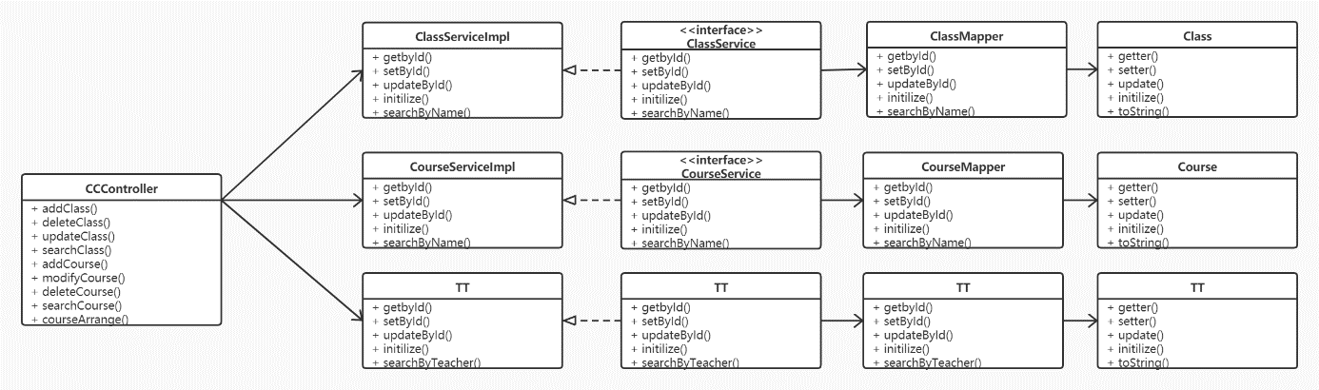
Chapter Four System Design
Course and class management module
Class diagram

Slide 21
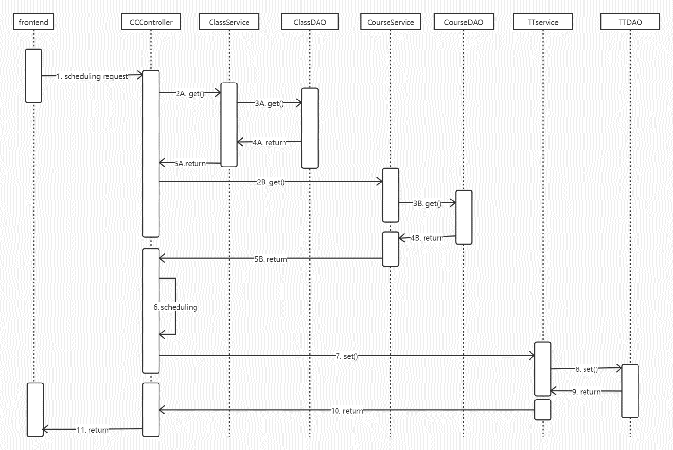
Chapter Four System Design
Course and class management module
Flow chart of course arrangement
Notes:
35s

Slide 22
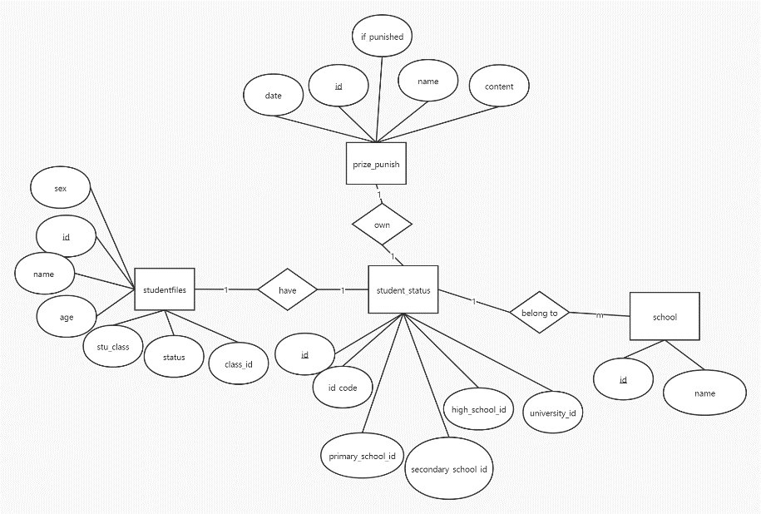
Chapter Four System Design
Database Design
The ER model of student information management module
Notes:
15~20s

Slide 23
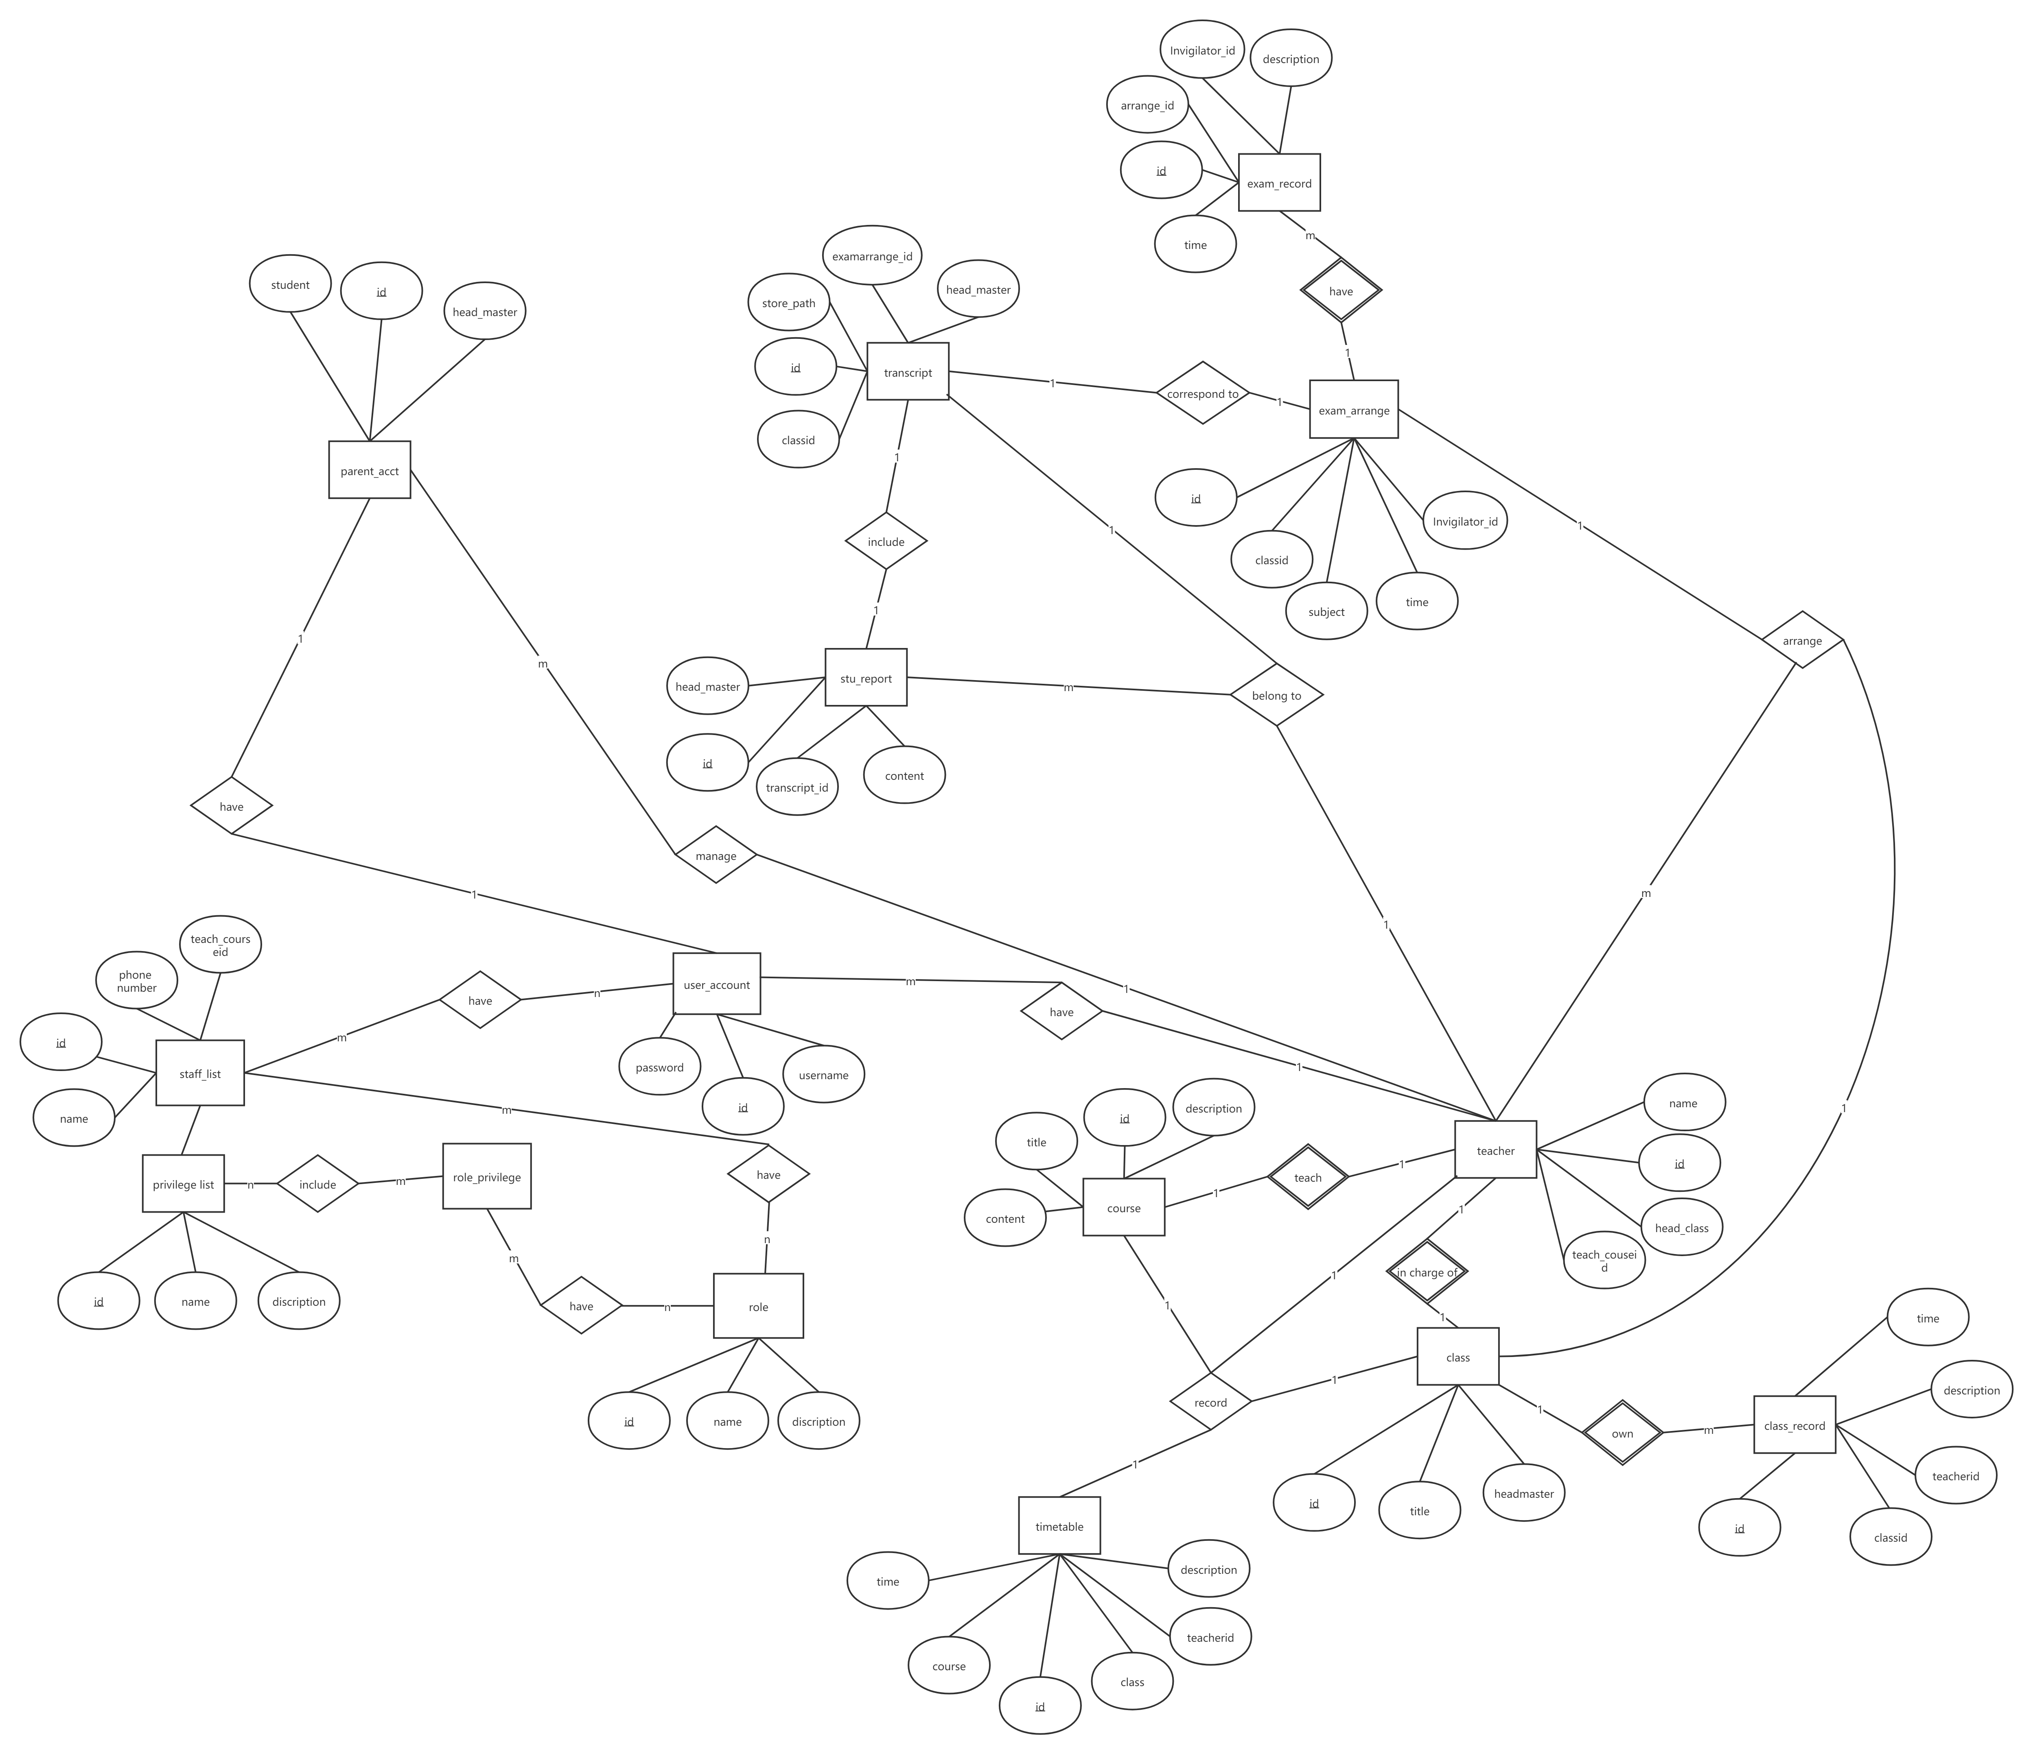
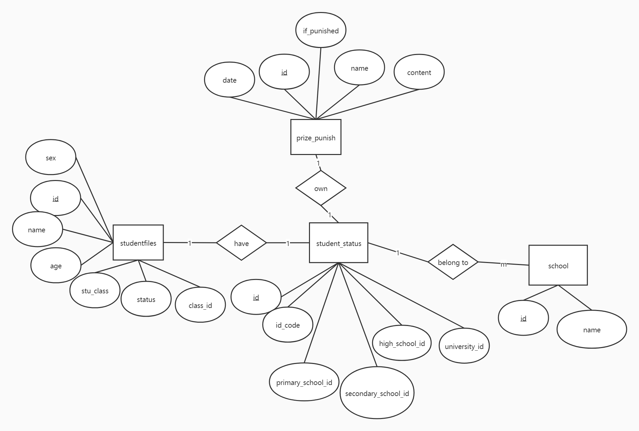
Chapter Four System Design
ER to Relation
Notes:
Transition 5~10s

Slide 24
Chapter Four System Design
Create Table
CREATE TABLE `student_status`
(
`id` int NOT NULL,
`id_code` varchar(255) NOT NULL,
`primary_school_id` int NULL DEFAULT NULL,
`secondary_school_id` int NULL DEFAULT NULL,
`high_school_id` int NULL DEFAULT NULL,
`university_id` int NULL DEFAULT NULL,
PRIMARY KEY (`id`) USING BTREE,
INDEX `primary_school_id`(`primary_school_id`) USING BTREE,
INDEX `secondary_school_id`(`secondary_school_id`) USING BTREE,
INDEX `high_school_id`(`high_school_id`) USING BTREE,
INDEX `university_id`(`university_id`) USING BTREE,
CONSTRAINT `student_status_ibfk_1` FOREIGN KEY (`primary_school_id`) REFERENCES `school` (`id`) ON DELETE RESTRICT ON UPDATE RESTRICT,
CONSTRAINT `student_status_ibfk_2` FOREIGN KEY (`secondary_school_id`) REFERENCES `school` (`id`) ON DELETE RESTRICT ON UPDATE RESTRICT,
CONSTRAINT `student_status_ibfk_3` FOREIGN KEY (`high_school_id`) REFERENCES `school` (`id`) ON DELETE RESTRICT ON UPDATE RESTRICT,
CONSTRAINT `student_status_ibfk_4` FOREIGN KEY (`university_id`) REFERENCES `school` (`id`) ON DELETE RESTRICT ON UPDATE RESTRICT
)
SET FOREIGN_KEY_CHECKS = 1;
Notes:
10s

Slide 25
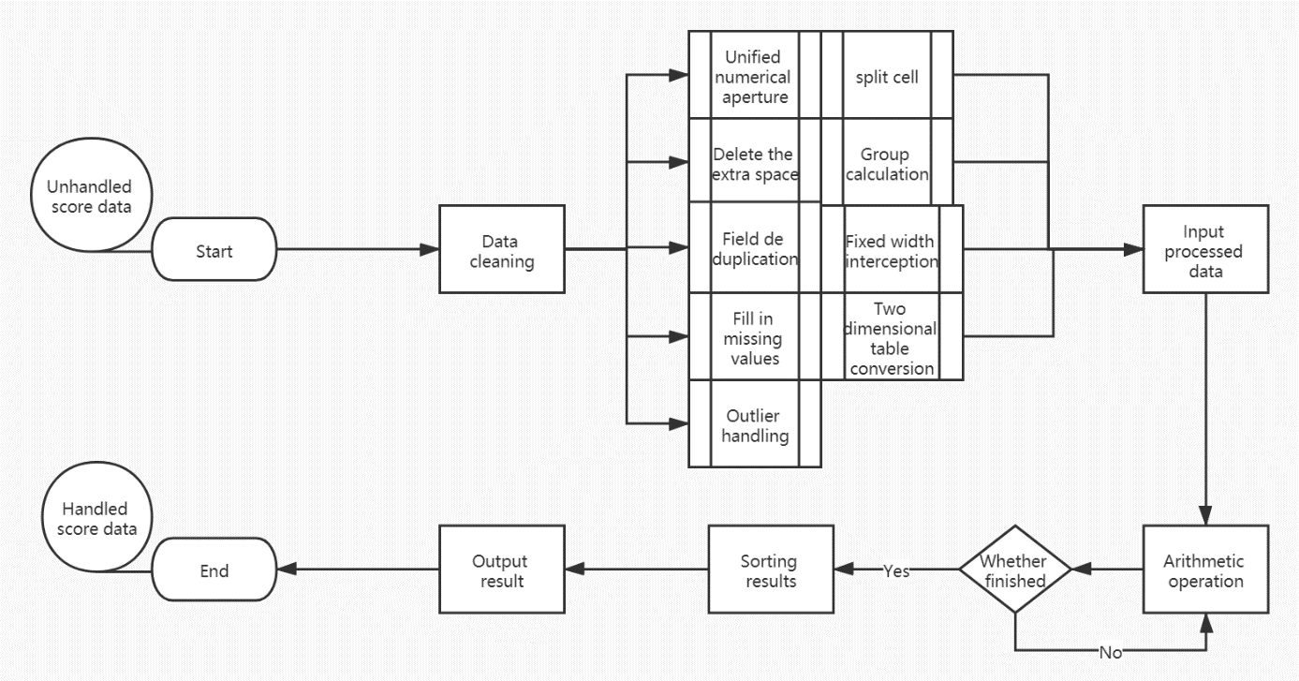
Chapter Four System Design
Algorithm Design
Analysis algorithm
Notes:
25~30s

Slide 26
V. System Implementation
Notes:
Transition 5s

Slide 27

Chapter Five System Implementation
public class UserController extends BaseController {
@Autowired
UserService userService;
@PostMapping("/checkUser")
public BaseModelJson<List<User>> checkUserForVue(@RequestBody User user) {
Map<String, Object> map = new HashMap<>();
("username", user.getUsername());
map.put("password", user.getPassword());
List<User> users = userService.getAllByFilter(map);
if (users.size() == 0) {
throw BusinessException.USERNAME_NOT_EXISTS;
} else {
BaseModelJson<List<User>> result = new BaseModelJson<>();
result.code = 200;
result.data = users;
return result;
}
}
...
}
Login Page
public class TokenCache {
private static final String TOKEN_KEY = "token_";
private static Cache<String,String> cache = CacheBuilder.newBuilder().build();
public static void setToken(String username,String token) {
cache.put(TOKEN_KEY+username,token);
}
public static String getTokenFromCache(String username){
return cache.getIfPresent(TOKEN_KEY+username);
}
}
Notes:
Login page 15s

Slide 28
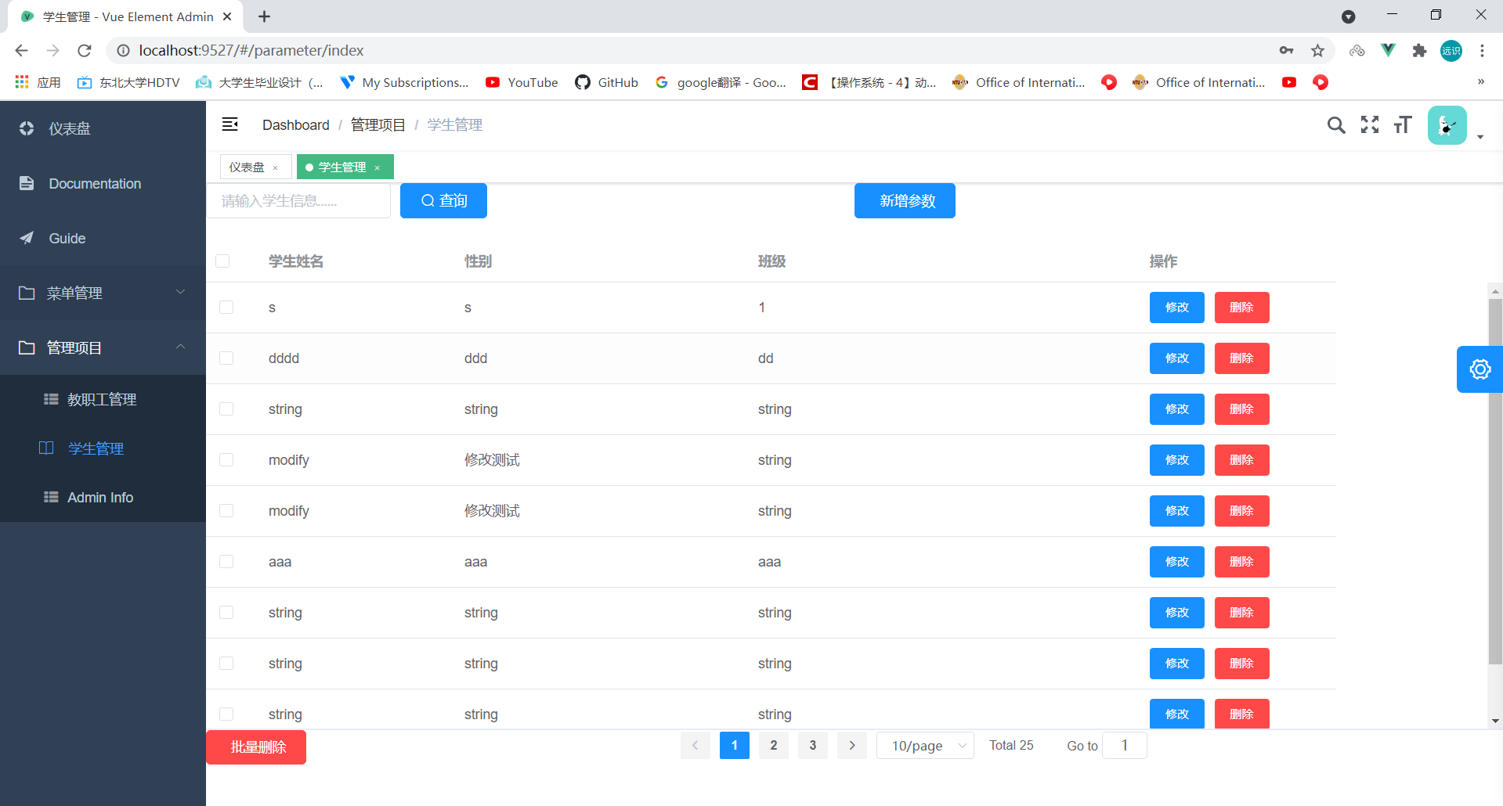
Chapter Five System Implementation
public class StuController extends BaseController {
@Autowired
StuService stuService;
//add new stu
@RequestMapping("/insertStu")
public BaseModel insertStu(@RequestBody Stu stu, BindingResult bindingResult){
if (bindingResult.hasErrors()){
throw BusinessException.INSERT_FAIL.newInstance(this.getErrorResponse(bindingResult),
new Object[]{stu});
}else {
int i = stuService.insertStu(stu);
BaseModel result = new BaseModel();
…
return result;
}
}
//modify stu
@RequestMapping("/updateStu")
public BaseModel updateStu(@RequestBody Stu stu, BindingResult bindingResult){
if (bindingResult.hasErrors()){
throw BusinessException.UPDATE_FAIL.newInstance(this.getErrorResponse(bindingResult),
new Object[]{stu});
}else {
int i = stuService.updateStu(stu);
BaseModel result = new BaseModel();
…
return result;
}
}
@RequestMapping("/searchStuByCd")
public BaseModelJson<List<Stu>> searchStuById(@RequestBody Stu Stu){
List<Stu> resultList = stuService.searchStuById("%"+stu.getStuam_cd()+"%");
BaseModelJson<List<Stu>> result = new BaseModelJson();
result.data = resultList;
…
return result;
}
……
}
Student information
Notes:
Student information 25s

Slide 29
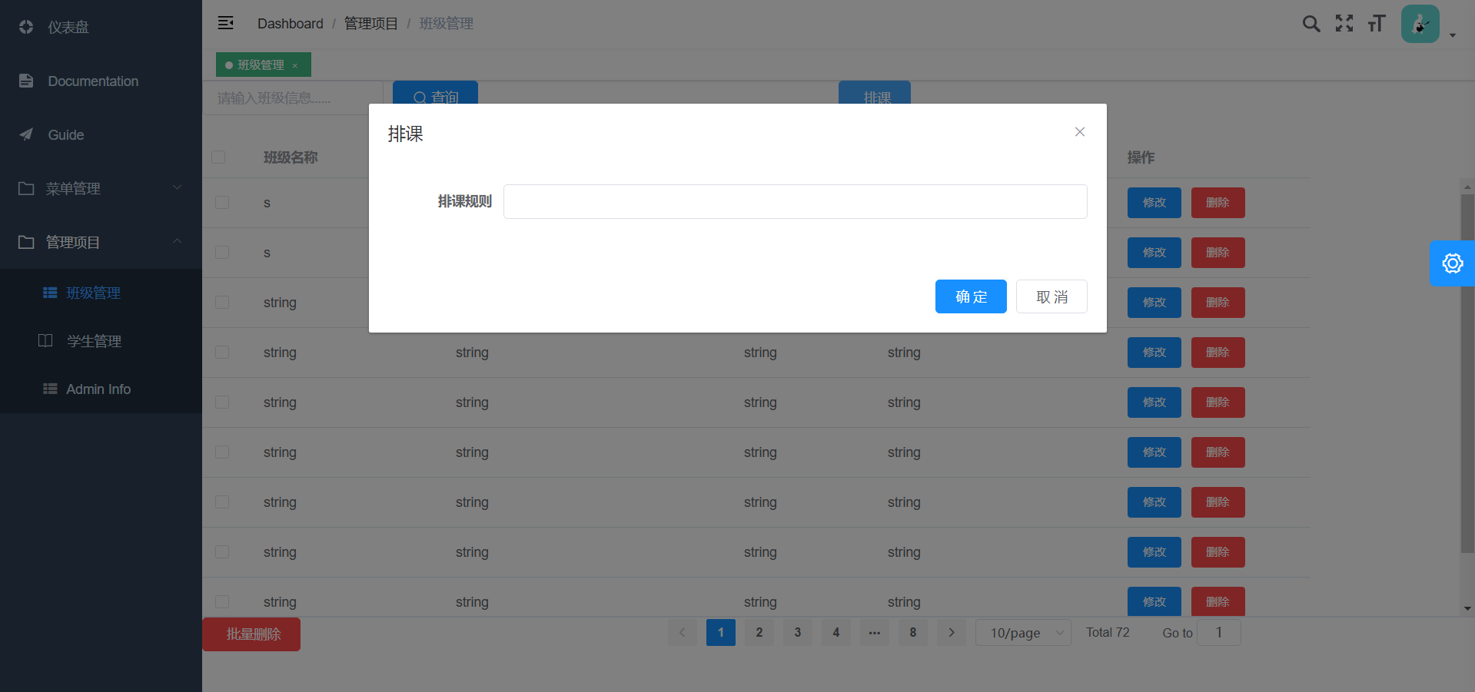
Chapter Five System Implementation
Course and class arrangement
public BaseModelJson<List<TT>> autoScheduling(@RequestBody Rule rule,
BindingResult bindingResult){
if (bindingResult.hasErrors()){
…
}else {
…
int num[] = rule.num;//Number of each courses
int eachNum = rule.eachNum//The number of courses arranged per week
TimePd timePd[] = new TimePd(allClass);//Time period of class every day
Courses courses = new Courses(num[]);//Course array'
TT tt = new TT();//result timetable
//Intitlaize
Iterator classList= allClass.iterator();
while(classList.hasNext()){
int flag = 0;
for (int timeSeg = 1;timeSeg <= 40;timeSeg++){
/**Check whether the same teacher has conflicts in teaching two or more classes at the same time.*/
If (timePd[timeSeg].checkTeacherCollision() == 0){
timePd[timeSeg] = courses.randomSelect();
tt.add(timePd[timeSeg]);
} else{
timePd[timeSeg] = courses.solveCollisionSelect();
tt.add(timePd[timeSeg]);
}
}
int signal = ttService.saveTimetable(tt);
classList.next();
}
…
return result;
}
}
Notes:
Scheduling rules page 25~30s

Slide 30
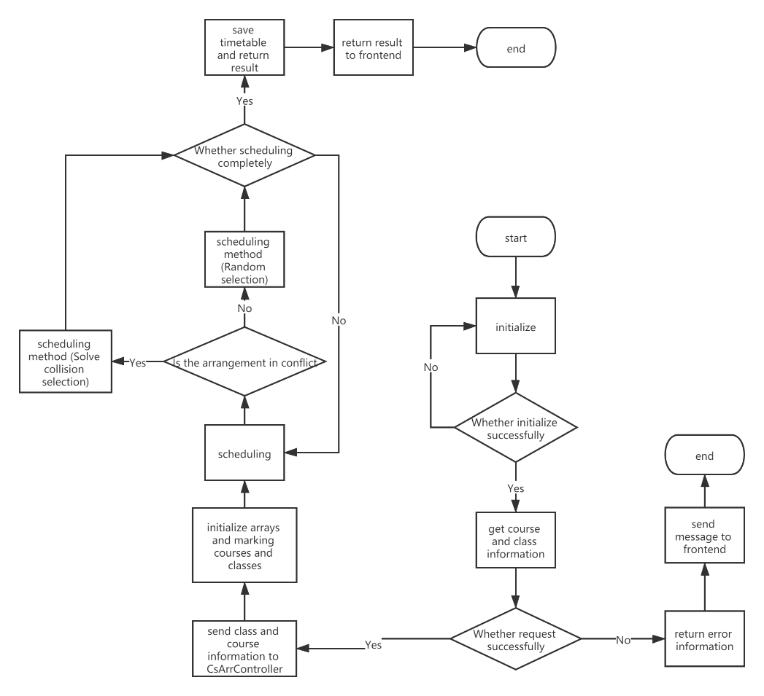
Chapter Five System Implementation
Program flow chart of scheduling
Notes:
Flow chart 40~50s

Slide 31
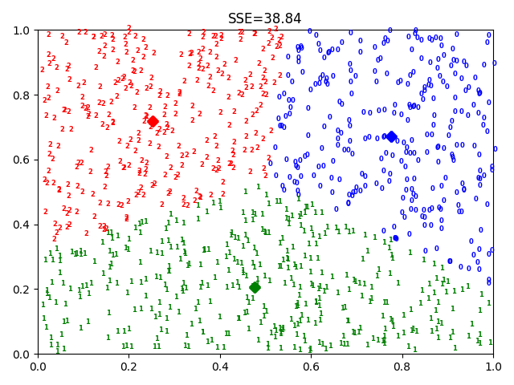
Chapter Five System Implementation
Achievement analysis basic algorithm realization
def _randomCent(self, data, k):
n = data.shape[1] # get the deminsion
centroid_matrix = np.empty((k, n))
for i in range(n):
minValue = min(data[:, i])
rangeI = float(max(data[:, i] - minI))
centroid_matrix[:, i] = (minI + rangeI * np.random.rand(k, 1)).flatten()
return centroid_matrix
def _pCent(self, data, k):
n = data.shape[1] # get the deminsion
centroid_matrix = np.empty((k, n))
for i in range(n):
for j in range(threshold):
cent_matrix[:, i] = self.genC(data)
…
return cent_matrix
for i in range(k): # update centroid
indexs = self.clusterAssment[:, 0] # retrieve the index value of the cluster to which the sample belongs
value = np.notzero(indexs == i) # retrieve all index values belonging to the ith cluster
ptsInClust = data[value[0]] # take out all the sample points belonging to the ith cluster
self.centroids_matrix[i, :] = np.mean(ptsInClust, axis=0) # calculate the mean value
……………………………………………………………………………………………….
for v in range(maxIter):
clusterChanged = False
for i in range(m): # each sample point is assigned to the family of its nearest centroid
minDist = np.inf
minIndex = -1
for j in range(k): # search for the nearest centroid
for j in range(k): # search for the nearest centroid
arrA = self.centroid_matrix[j, :]
arrB = data[i, :]
distJI = calEulerDist(arrA, arrB) # calculation error
if distJI < minDist:
minDist = distJI
minIndex = j
if self.clusterAssment[i, 0] != minIndex or self.clusterAssment[i, 1] > minDist ** 2:
clusterChanged = True
self.clusterAssment[i, :] = minIndex, minDist ** 2
if not clusterChanged: # the algorithm converges and ends the iteration
break
SSE: within-cluster sum of squared errors(cluster inertia)

Slide 32
VI. System Test
Notes:
Transition 5s

Slide 33
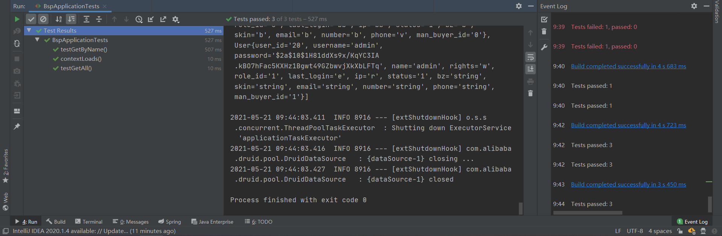
Chapter Six System Test
Unit Test
JUnit Test
Notes:
Junit 10s

Slide 34
Chapter Six System Test
Use case Test
Student status query test case
User login test case
Function | Inquiry of student status
Purpose | Test whether the student status query function can work normally
Precondition | System users log in normally and have the right to query the student status information.
Input/Action | Expected output/Result | Actual output | Conclusion
Click the “search all” button to query the status of all students | The list of all students with student status in our school and the information of student status will be displayed | Same as expected | Successful function implementation
Click on the student's entry | Pop up the student's detailed personal information and student status information | Same as expected | Successful function implementation
Enter the student's name or student number in the search box | The page displays the student status information of the corresponding students | Same as expected | Successful function implementation
Enter the incorrect student information to do the query | The pop-up information on the interface indicates that the user's input information is incorrect | Same as expected | Successful function implementation
Function | User login
Purpose | Check whether the user can log in the system normally and the system automatically reads the user permissions
Precondition | The system is successfully deployed to the server and can work normally, and the user browser software can run normally
Input/Action | Expected output/Result | Actual output | Conclusion
The user enters the correct username and password in the prompted position and clicks the login button | The system automatically jumps to the main interface from the login page, and lists the function menu according to the user group | Login successful and menu loaded successfully | Successful function implementation
Users click forget password connection, input personal name and mobile phone number, and then click the confirm button | The user receives the message confirming the modification and enters the correct verification code to successfully modify the password | Modify successfully and give feedback to the user. | Successful function implementation
The user entered the wrong username or password and click the login button | The system prompts the input error and feeds back the number of remaining input attempts to the user | Same as expected | Successful function implementation
Notes:
Use case Test 25s

Slide 35
VII. Summary
and
Prospect
Notes:
Transition 5s

Slide 36
Chapter Seven Summary and Prospect
Summary
Receiving Project
Requirement Analysis
Design
Thesis & Report
System Test
Implementation

Slide 37

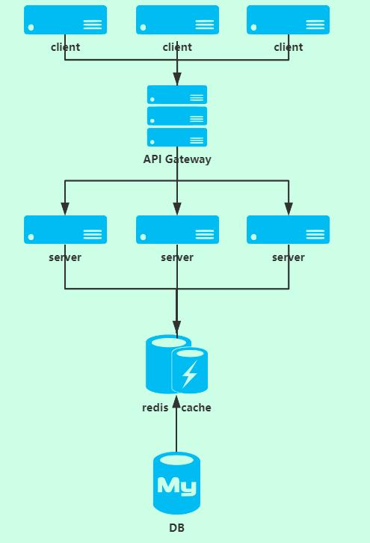
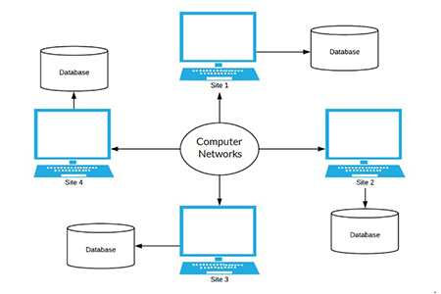
Chapter Seven Summary and Prospect
Prospect
3. Use Redis cache technology to reduce system query time
1. Enrich the diversity of parent function client
2. Use DDBMS (Distributed database management system) architecture.

Slide 38
Thank you!
Northeastern University
Software Engineering(International (English))
Respondent
Supervisor
Zhang Mingwei
Li Yuanshi
Class
Student ID
20172259
1702
Notes:
End 5~10s

